Slide 1
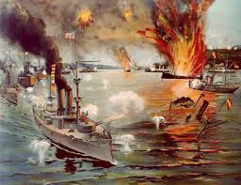
SPANISH-AMERICAN WAR
1895-1900
Notes:
US DVD Clip (4)

Slide 2
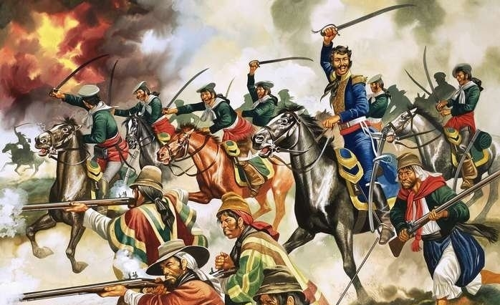
spanish oppression
Colonies of Central and South America
By 1897, most of the colonies had revolutions
Freed themselves from Spain and Portugal
Spain was barely still a superpower and was harsh towards its remaining colonies

Slide 3
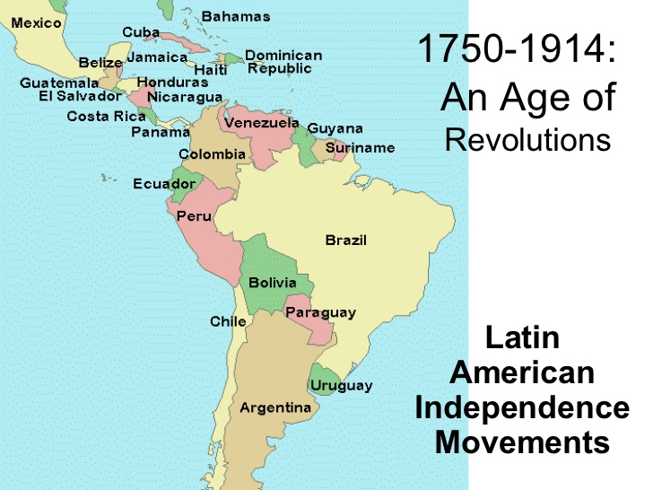
spanish oppression

Slide 4
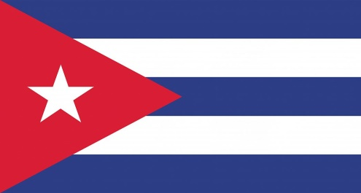
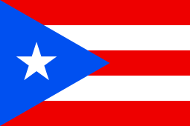
Spanish colonies
Remaining Spanish colonies in 1897
Cuba
Puerto Rico
Philippines
Guam

Slide 5
Cuban Rebellion
Holding the colonies
Cuba fought against the Spanish from 1868 to 1878 in the 10 Years War
Cuba fought for independence and lost
Second rebellion
In 1895, the Cubans had a second rebellion
Defeated again
Spain refused to give up Cuba because of the value of sugar cane

Slide 6
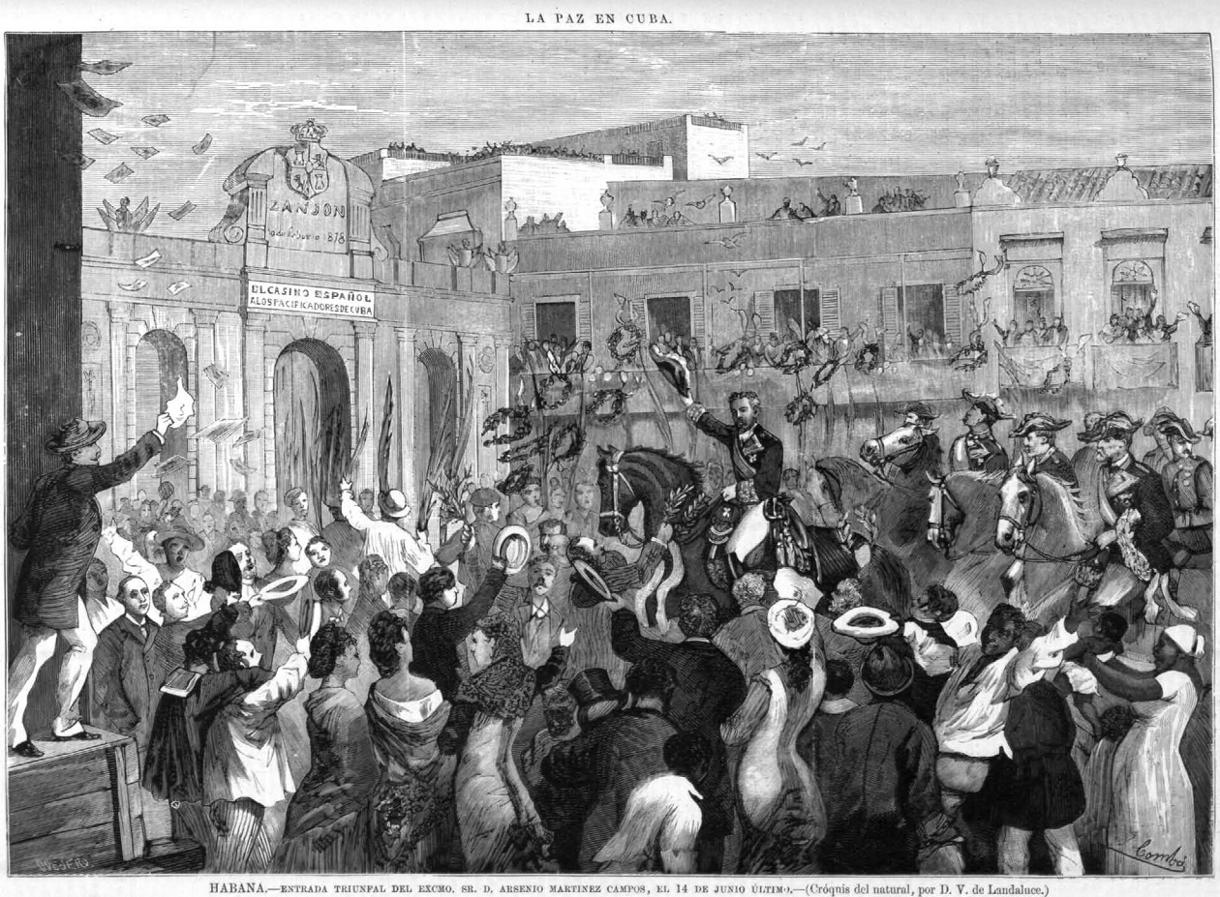
Cuban Rebellion

Slide 7
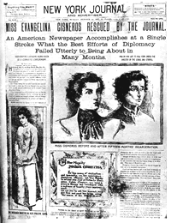
U.S. Perspective
Treatment of civilians
Reports of abuse by the Spanish began to spread
Citizens were beaten and jailed over the smallest of offences
American newspapers began reporting some of the cases
Some fake stories were published just to stir people up
Also known as Yellow Journalism

Slide 8
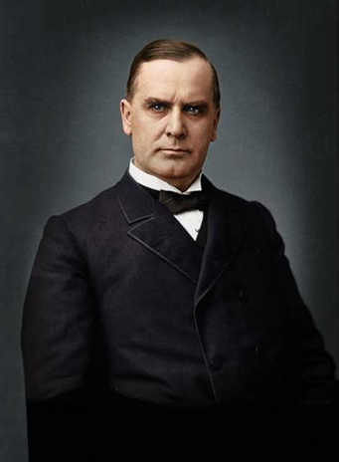
President MCKinley
President William McKinley
25th U S President (R)
1897-1901
Pro-business and economics
Annexed Hawaii
Made America a superpower
Argued as the “First Modern President”
Rated as above-average

Slide 9
U.S. Response
Effect of Yellow Journalism
A majority of US citizens supported the idea of war
Trade with Cuba was being negatively affected
Diplomacy first
McKinley tried to have negation meetings to, but Spain refused
When Spain finally agreed, the Cuban rebels refused to have peace
Spain’s Response
The Spanish governor of Cuba fled the country
The US sent a ship to Cuba, which was sunk in the harbor

Slide 10
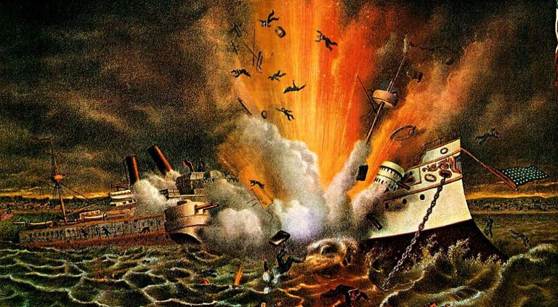
USS MAINE
February 15th, 1898
The USS Maine was at a harbor in Havana Cuba
A sudden explosion sunk the ship
At the time, the US blamed Spain for sinking the ship
This made Americans support the idea of war even more

Slide 11
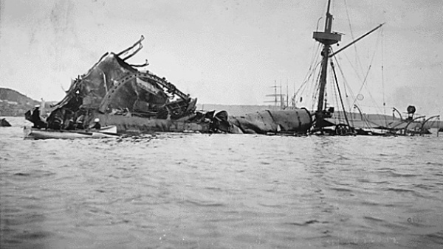
USS MAINE

Slide 12
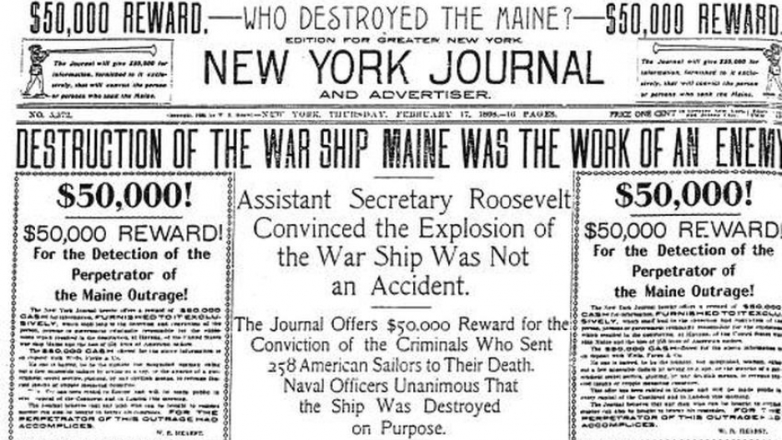
USS MAINE

Slide 13
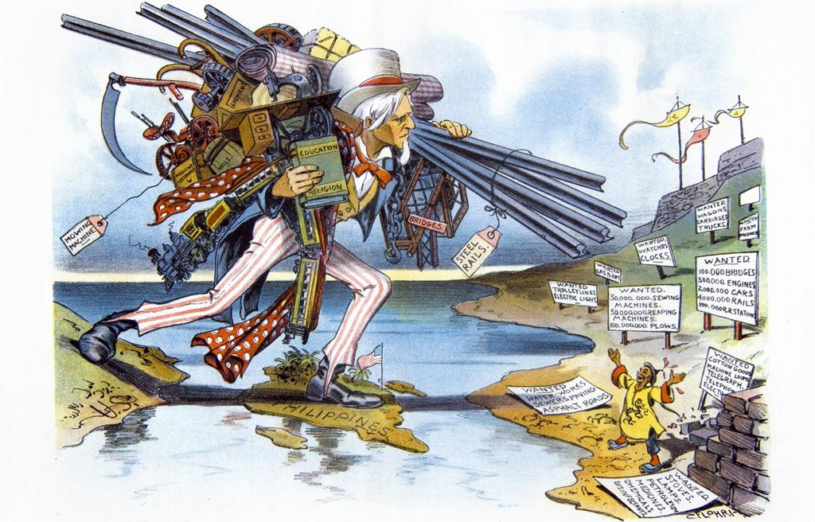
Declaring War
April 1898
McKinley and Congress send an ultimatum to Spain
Make Cuba free or prepare for war
Spain declines
The US Navy blockades Cuba
Spain and the US both declare war

Slide 14
Pacific Theater
Philippines
Battle of Manila Bay (April 27th)
Naval battle – Major American victory
Battle of Manila (August 13th)
Land battle – American victory (with rebel forces)
Guam
Capture of Guam (June 20th)
A single American ship forced the Spanish troops to surrender without fighting

Slide 15
Caribbean Theater
Dozens of battles happened in the Caribbean between the US and Spain
A majority were American victories
Major battles
Two Battles of Cardenas (May 8th & 11th)
Battle of Guantanamo Bay (June 6th)
Battle Santiago (July 3rd)
Battles of San Juan (May 12th, June 22nd, June 28th)
Battle of Asomante (August 9th)
Ended the war

Slide 16
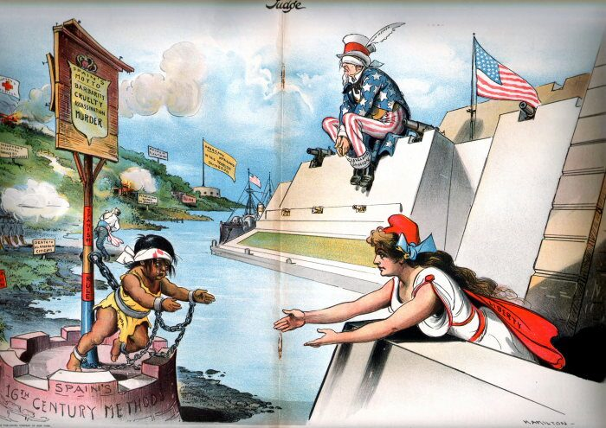
Aftermath

Slide 17
Aftermath
Treaty of Paris (1898)
Ended the war
Gave Puerto Rico, Guam, and the Philippines to the US
Cuba became a US protectorate
The Spanish-American was nicknamed the “Splendid little war”
The war also helped develop how the US would conduct foreign relations
The war also officially ended the Spanish Empire

Slide 18
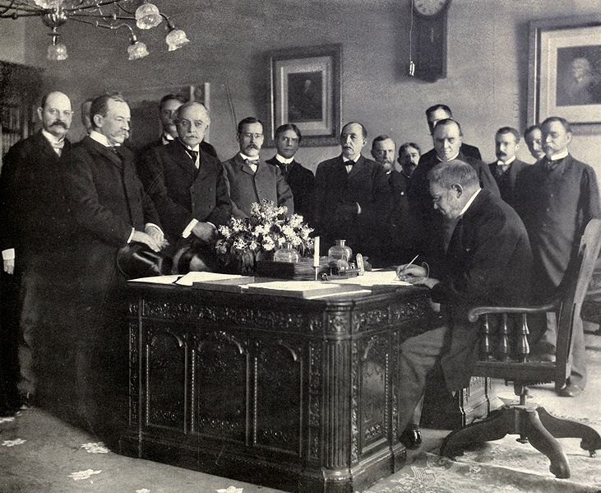
Aftermath

Slide 19
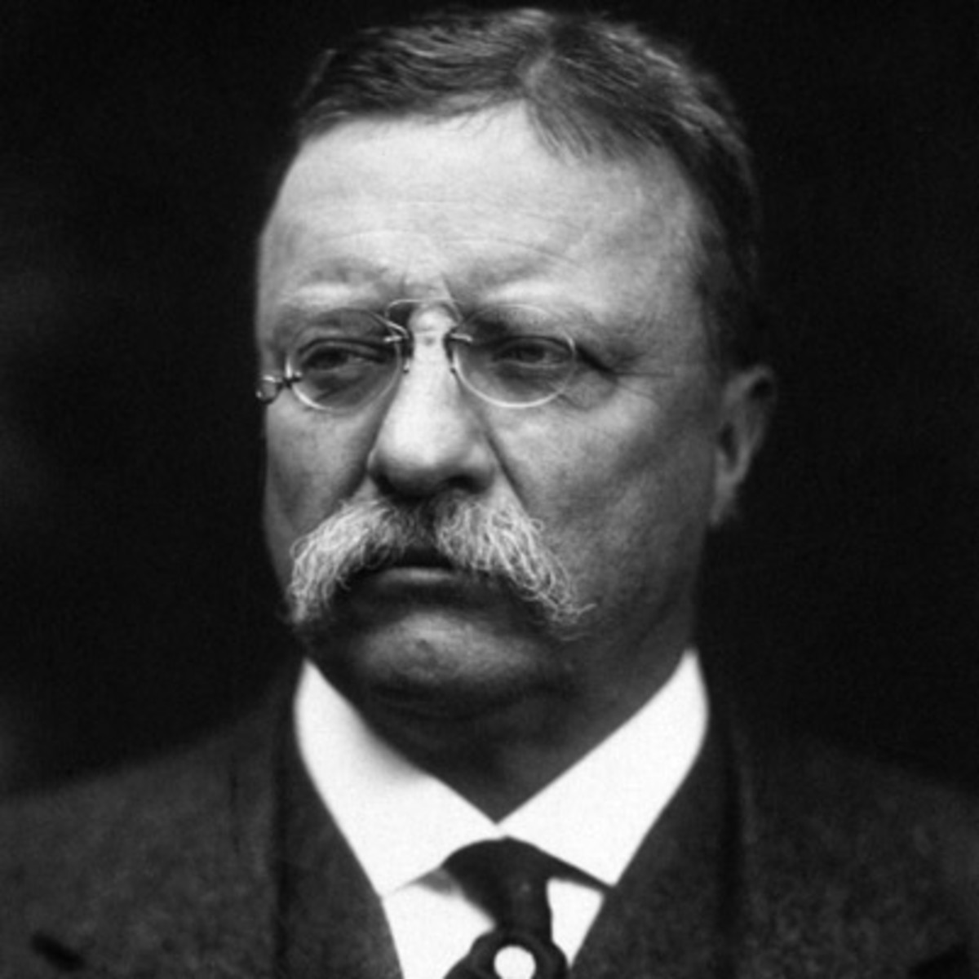
Teddy Roosevelt
Theodor Roosevelt
Aka – Teddy
Former cowboy in the west
Became a police commissioner
Colonel of a volunteer cavalry regiment in the Spanish-American War
The “Rough Riders”
Became Governor of New York
Became Vice President
Became the 26th President
Survived an assassination attempt at a rally

Slide 20
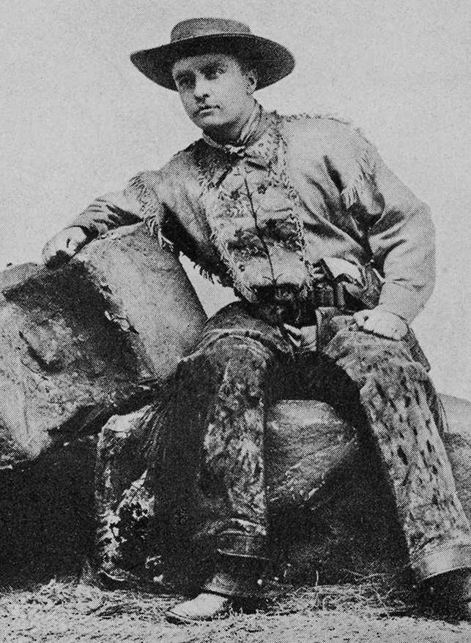
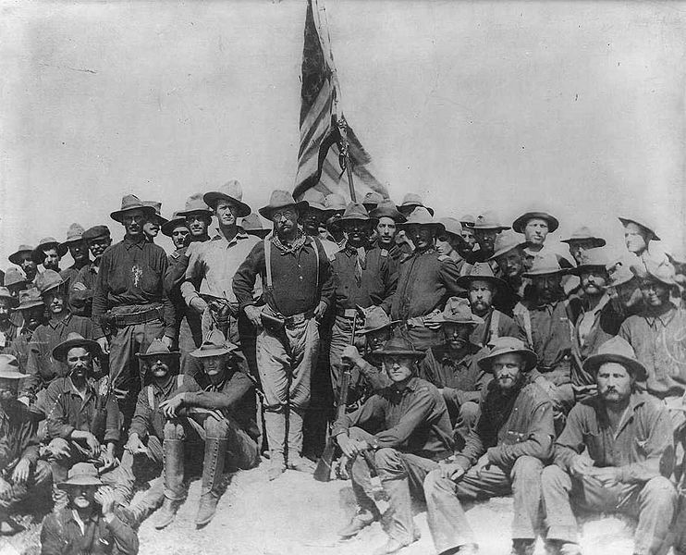
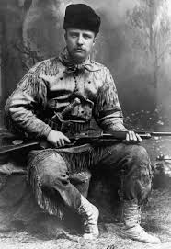
Teddy Roosevelt

Slide 21
END
QUIZ

